Slide 1
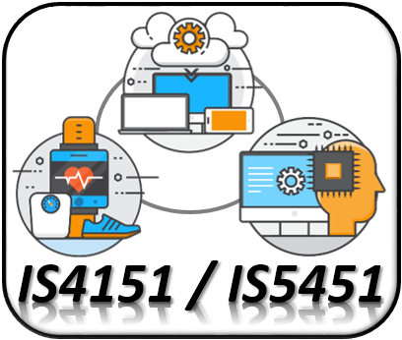
IoT Data Preprocessing IS4151/IS5451 – AIoT Solutions and Development AY 2024/25 Semester 2
9
Lecture
Lecturer: A/P TAN Wee Kek
Email: tanwk@comp.nus.edu.sg :: Tel: 6516 6731 :: Office: COM3-02-35
Consultation: Tuesday, 2 pm to 4 pm. Additional consultations by appointment are welcome.

Slide 2

Quick Recap…
In the previous lecture, we learnt:
How to connect a node device or hub to a fog processor or cloud server thereby integrating all three architectures of edge, fog and cloud.
RESTful web services can be created in Python with Flask and Connexion.
IoT sensor data sent to a cloud server can be persisted into a relational database.
This lecture kickstarts our learning journey to find out how to use these data for AI machine learning.
IoT Development
AI Machine Learning
Single-board Microcontroller
Single-board Computer
IoT Backend Integration
Android Development for IoT
IoT Data Preprocessing
Machine Learning for IoT Data
Computer Vision for IoT
IoT Architecture, Design and Protocols
Pervasive Computing
Technical Concepts
Introduction to Artificial Intelligence of Things

Slide 3

Learning Objectives
At the end of this lecture, you should understand:
More about machine learning.
How to perform data preparation with Pandas.
How to perform data visualisation with Matplotlib.
IoT Development
AI Machine Learning
Single-board Microcontroller
Single-board Computer
IoT Backend Integration
Android Development for IoT
IoT Data Preprocessing
Machine Learning for IoT Data
Computer Vision for IoT
IoT Architecture, Design and Protocols
Pervasive Computing
Technical Concepts
Introduction to Artificial Intelligence of Things

Slide 4

Readings
Required readings:
None.
Suggested readings:
None.

Slide 5

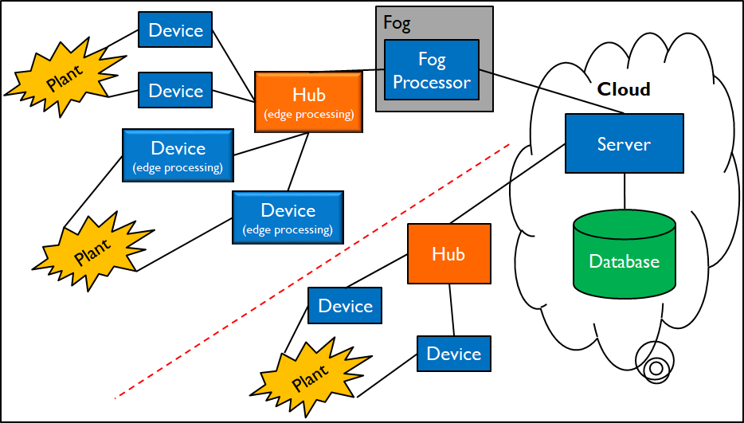
Technical Roadmap for IS4151/IS5451
Single-board Microcontroller
Android Wear
Single-board Computer
Android App
IoT Backend Integration
AI & ML

Slide 6
More About Machine Learning

Slide 7
More About Machine Learning
Recall that machine learning employs statistical and mathematical techniques to build a model based on sample data
The objective is to identify patterns among variables in the data, i.e., data mining:
Data mining involves three main patterns:
Prediction
Segmentation
Data Mining
Classification
Regression
Association

Slide 8
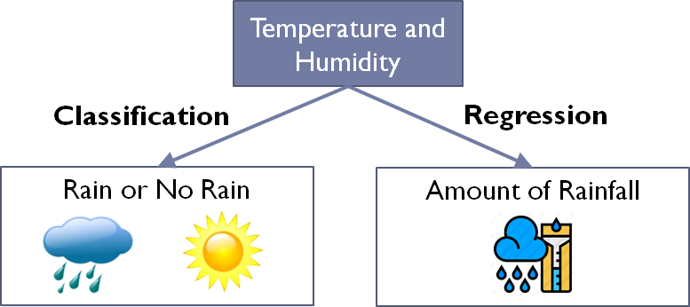
More About Data Mining
Prediction:
Forecast the outcome of future event or unknown phenomenon.
Intuitively, we can think of prediction as learning an A→B mapping, where A is the input and B is the output.
Classification – Predict weather outlook:
A are weather data such as temperature and humidity.
B is a class label representing the weather outlook such as “Rain” or “No Rain”.
Regression – Predict rainfall:
A are weather data such as temperature and humidity.
B is a real number representing the amount of rainfall in millimeter.

Slide 9
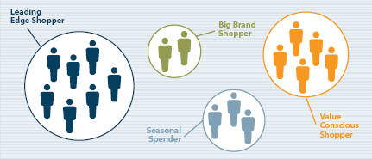
More About Data Mining (cont.)
Segmentation:
Partition a collection of things (e.g., objects, events) in a dataset into natural groupings.
Clustering:
Create groups so that the members within each group have maximum similarity.
Members across groups have minimum similarity.
Examples:
Segment daily temperature data into hot day or cold day.
Segment customers based on their demographics and past purchase behaviors.

Slide 10
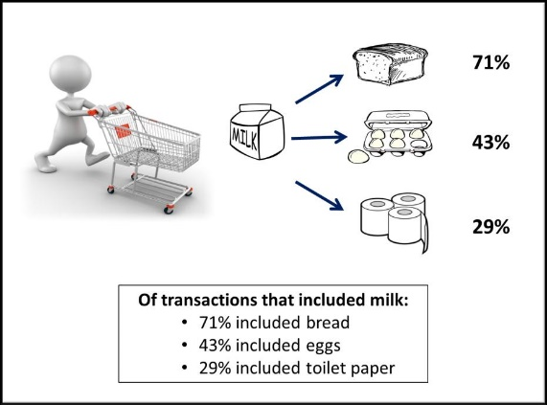
More About Data Mining (cont.)
Association:
Discover interesting relationships among variables in a large database.
Market Basket Analysis:
Discover regularities among products in largescale transactions recorded by point-of-sale systems in supermarkets:
I.e., each product purchased in a transaction being a variable.
Identify products that are commonly purchased together, e.g., beer and diaper.

Slide 11
More About Data Mining (cont.)
Data mining tasks to extract the different types of patterns rely on learning algorithms.
Learning algorithms can be classified according to the way patterns are extracted from historical data.
Supervised learning method :
Training data include both independent variables and dependent variable
Unsupervised learning method:
Training data include only the independent variables.

Slide 12
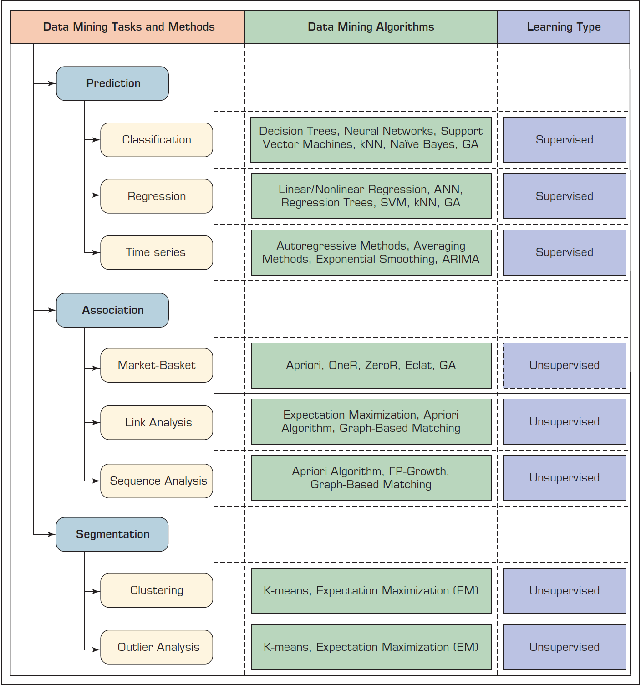
More About Data Mining (cont.)
Prediction involve A → B mapping in which we know the B to help determine the pattern.
This is known as supervised learning.
Association and Segmentation involve just A without the B.
We determine the pattern without the help of the B.
This is known as unsupervised learning.
Source: Sharda et. al. (2020) – Analytics, Data Science, & Artificial Intelligence: Systems for Decision Support, pp. 206, Figure 4.2

Slide 13
Classification versus Clustering – A Concrete Example
The Zoo animals dataset consists of 101 animals and 18 variables:
Name of the zoo animal, i.e., the identifier.
Type of the zoo animal, i.e., the class label:
7 types – Amphibian, bird, fish, insect, invertebrate, mammal, and reptile.
A set of variables describing the characteristics of each animal:
15 Boolean-valued variables such as hair, feathers, eggs and milk.
1 numeric-valued variable, i.e., number of legs (0 to 8).

Slide 14
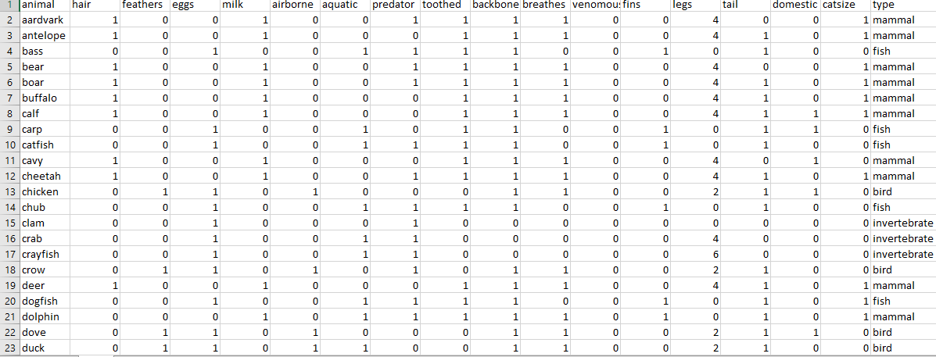
Classification versus Clustering – A Concrete Example (cont.)
Identifier
Descriptive Attributes
Class Attribute

Slide 15
Classification versus Clustering – A Concrete Example (cont.)
Classification:
Use decision tree classifier to learn the function or mapping between the characteristics of animals and their membership to each type.
This is a supervised learning process.
Use a common two-step methodology:
Model training and then follow by model testing.
In this case, we are using a simple split validation.
70% of sample is used to train the model and derive a decision tree.
30% of sample is used to test the model.

Slide 16
Classification versus Clustering – A Concrete Example (cont.)
Compute the predictive accuracy, i.e., the model’s ability to correctly predict the class label of new or previously unseen data:
A.k.a. testing accuracy.
In this example, the predictive accuracy is about 90% (random stratified sampling).
See src01 for more details.

Slide 17
Classification versus Clustering – A Concrete Example (cont.)
Clustering:
Uses k-means clustering algorithm, a traditional statistical analysis technique.
A predetermined number of clusters is defined, denoted by k.
The algorithm assigns each data point (in this case each animal) to the cluster whose center, i.e., centroid, is the nearest:
Centroid is calculated as the average of all the points in the cluster.
Coordinates of the centroid are the arithmetic mean for each dimension separately over all the points in the cluster.
Unsupervised learning process – The class label, i.e., animal type, is not used by the algorithm.
In this example, we use k=2 and k=7 for comparison.

Slide 18
Classification versus Clustering – A Concrete Example (cont.)
Cannot compute the predictive accuracy because we are not supposed to know the actual class label.
The quality of a clustering model is evaluated using other statistical measures.
See src02 and src03 for more details.

Slide 19

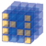

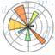
Overview of SciPy
The Python ecosystem consists of various open-source libraries for mathematics, science, and engineering applications.
Some of the core packages include:
NumPy – Base N-dimensional array package.
Pandas – Data structures & analysis.
Matplotlib – Comprehensive 2D Plotting.

Slide 20
Overview of the NumPy Library
The built-in tools provided by the standard Python library may be too simple or inadequate for data analysis calculation.
NumPy is the basic package for scientific computing in Python.
It forms the basis for many other mathematical and scientific Python packages.
NumPy library is based on one main object, i.e., ndarray, which stands for N-dimensional array:
ndarray is a multidimensional homogeneous array with a predetermined number of items.
All items are of the same type and the same size.

Slide 21

Overview of the NumPy Library (cont.)
NumPy library operates on the ndarray object to support calculation of multidimensional arrays and large arrays.

Slide 22
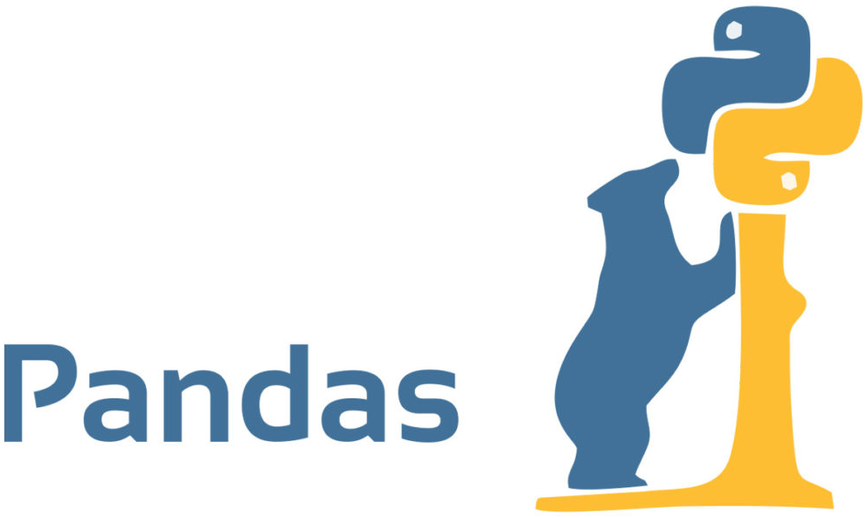
Overview of the Pandas Library
Pandas is an open source Python library for performing highly specialised data analysis.
It provides a single library for data analysts to easily process data, extract data and manipulate data, i.e., data preparation.
Pandas is built upon the NumPy library.
The standard data structures provided by Python and the ndarray provided by NumPy are not ideal for working with relational data or labelled data.

Slide 23
Overview of the Pandas Library (cont.)
Pandas fills this important gap by providing two new data structures, namely Series and DataFrame.
Series and DataFrame provide data analysts with the data manipulation capability equivalent to SQL-based relational database within Python.
Data Preparation in Database with SQL
Python
Machine Learning in Python
Data Preparation in Python with Pandas

Slide 24

Overview of the Matplotlib Library
Data visualisation is an important part of data analytics as correct and efficient representation of data can improve understanding of the analysis.
Matplotlib is a Python library specialising in the development of two-dimensional charts (including 3D charts).
Key features:
Simplicity of usage.
Gradual development and interactive data visualisation.
Good control over graphics elements.
Exportable in many formats such as PNG, SVG and EPS.

Slide 25

Machine Learning with Scikit-Learn
Scikit-Learn is a Python library that integrates many machine learning algorithms:
It features various classification, regression and clustering algorithms.
E.g., support vector machines, random forests, gradient boosting and k-means.
It is designed to interoperate with the Python numerical and scientific libraries NumPy and Pandas.

Slide 26
Data Preparation

Slide 27
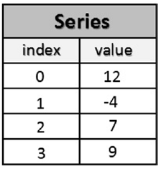
Series
Series is the Pandas object for representing one-dimensional data structures.
Similar to an array but with some additional features.
Internal structure is relatively easy and consists of two arrays associated with each other:
The main array holds the data (any NumPy type).
Each piece of data or element is associated with a label.
The label is contained within the other array.

Slide 28
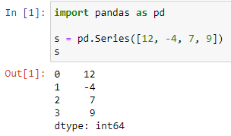

Creating a Series
To create a new Series:
Call the Series() constructor and pass in the list containing the values to be included in the series.
By default, the label is a zero-based index number.
So, the left column is a series of labels, and the right column is the corresponding values.
src04

Slide 29
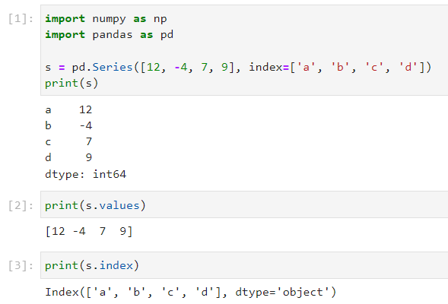
Creating a Series (cont.)
But it is preferable to create Series using meaningful labels:
Can distinguish and identify each item regardless of the order in which they were inserted into the Series.
This can be done by including the index option and assigning a list of strings containing the labels.
src05

Slide 30
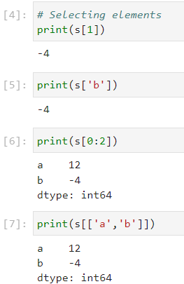
Selecting Elements in a Series
Internal elements in the Series can be selected as:
Ordinary numpy array, e.g., s[1]
Label corresponding to the position of the index s['b']
It is also possible to select multiple items.
src05

Slide 31
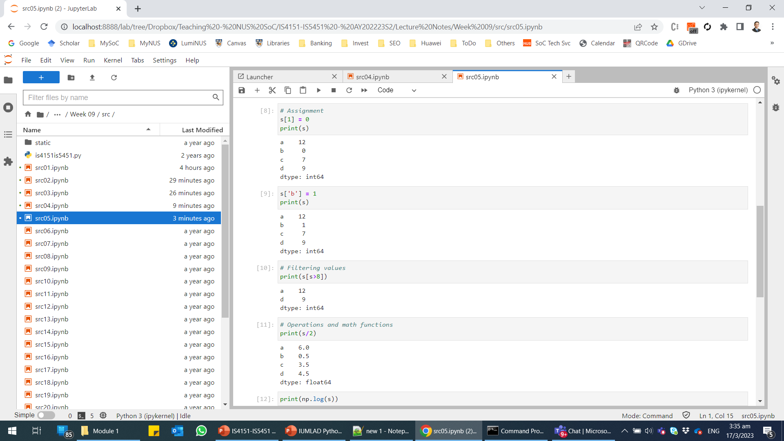
Selecting Elements in a Series (cont.)
New value can be assigned to individual elements using the assignment operator:
Individual elements can be filtered by their value using NumPy filter syntax:
src05
src05

Slide 32
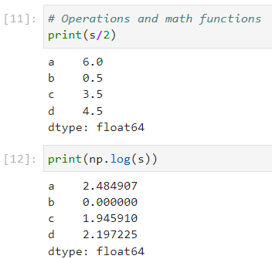
Basic Operations on Series
We can perform various operations and mathematical functions that are applicable to NumPy arrays to Pandas Series:
src05

Slide 33
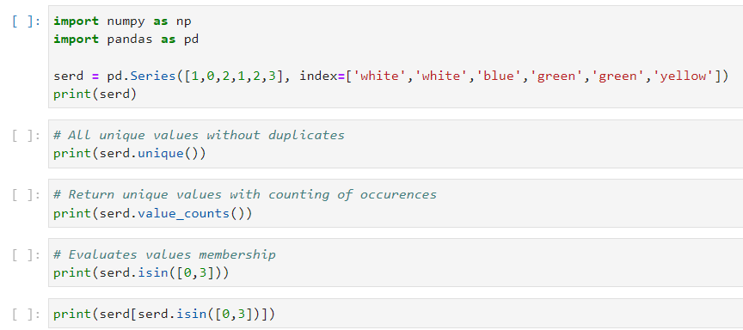
Basic Operations on Series (cont.)
Evaluating values within a Series provides information on:
What unique values do the samples contain – unique()
Counting duplicate values – value_counts()
Determine whether a value is present or not – isin()
src06

Slide 34
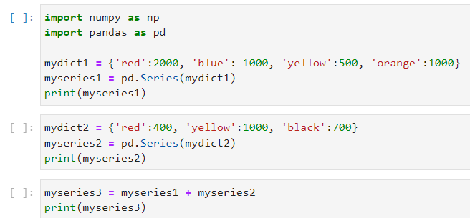
Basic Operations on Series (cont.)
Series can be created from a dict (dictionary) object as they are actually very similar in the general structure.
Finally, since we can perform arithmetic operation between a Series and a scalar value, we can do that between two Series too.
src07

Slide 35
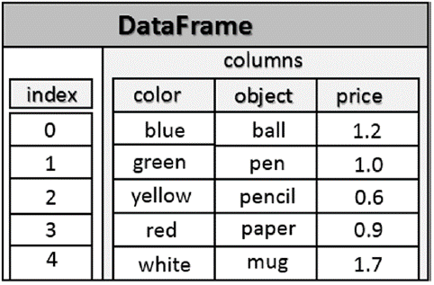
DataFrame
DataFrame is a tabular data structure very similar to a spreadsheet or relational database table.
It extends the Series to multiple dimensions/columns.
DataFrame is essentially an ordered collection of columns, each of which can contain values of different type.

Slide 36
DataFrame (cont.)
Recall that a Series has an index array containing labels associated with each element.
A DataFrame has two index arrays:
The first array is associated with the rows and serves a similar function as the index array in a Series.
In fact, each label in the first array is associated with all the values in the row → Think of this as the row header in a spreadsheet or primary key in a relational database table.
The second array contains a series of labels, each associated with a particular column → Think of this as the column header in a spreadsheet or column/attribute name in a relational database table.

Slide 37
DataFrame (cont.)
Another way to look at a DataFrame is to think of it as a dictionary of Series:
The keys are the column names.
The values are the Series.
Furthermore, all elements of each Series are mapped according to an array of labels called the index.

Slide 38
Defining a DataFrame
The most common way to define a DataFrame is to pass a dict object to the DataFrame() constructor:
The dict object contains a key for each column to be defined together with a list of values.
This approach is quite similar to how we define a Series but now we are essentially defining multiple Series objects to make up the DataFrame.

Slide 39
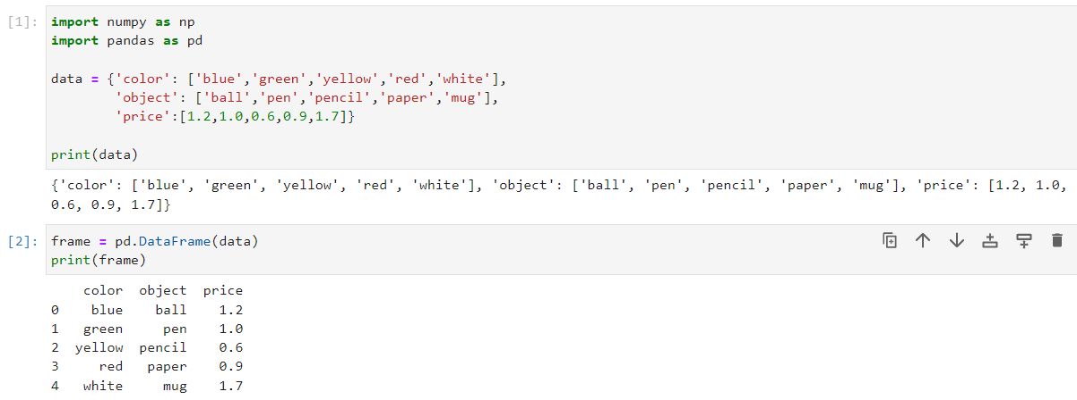
Defining a DataFrame (cont.)
src08

Slide 40
Selecting Elements in a DataFrame
We can obtain the name of all the columns and the list of indexes of the DataFrame object using its columns and index attributes, respectively.
The entire set of data in the DataFrame can be retrieved using the values attribute.
To select the contents of a column, we can use the column name as an index or use the column name as an attribute of the DataFrame.
To select the contents of a row:
Use the iloc attribute with the required positional index.
Use the loc attribute with the required label index (if one is defined with the index option)

Slide 41
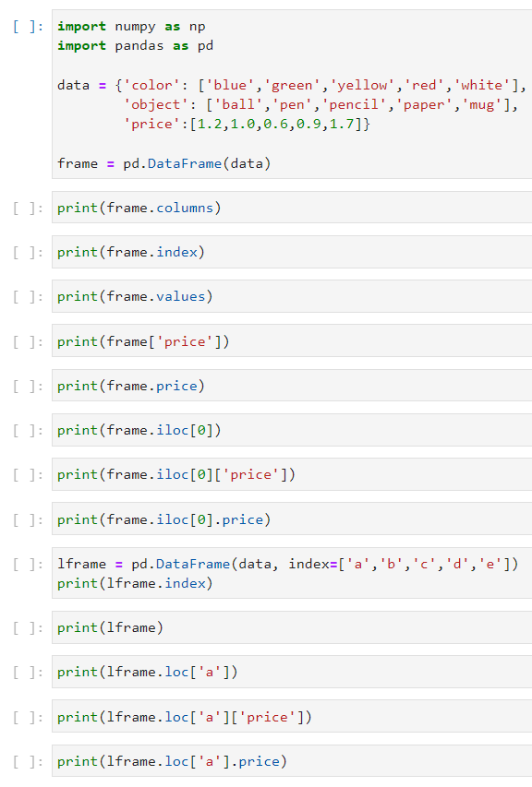
Selecting Elements in a DataFrame (cont.)
To select the content of a cell, we combine the iloc or loc attribute with the required column name.
src09

Slide 42
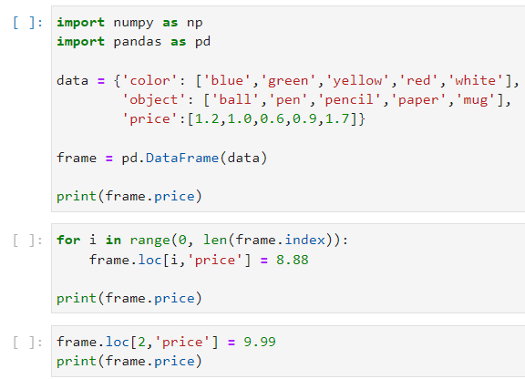
Selecting Elements in a DataFrame (cont.)
We can assign new value to each cell with the assignment operator and the loc attribute of the DataFrame.
src10

Slide 43
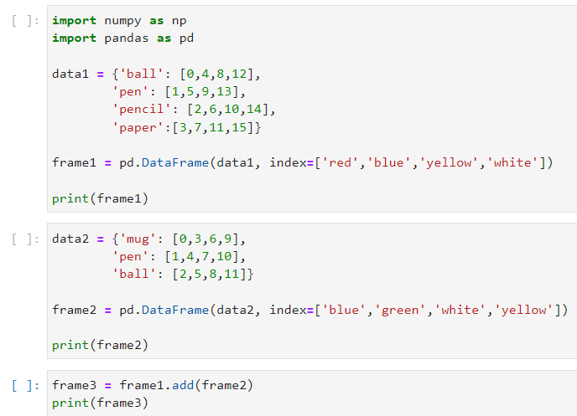
Basic Operations on DataFrame
Arithmetic operations can be performed between two DataFrame objects using the flexible arithmetic methods:
add()
sub()
div()
mul()
src11

Slide 44
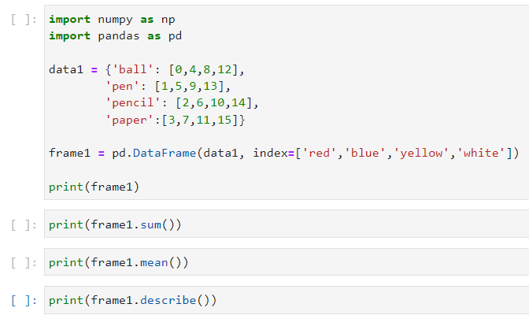
Basic Operations on DataFrame (cont.)
Statistic functions can be applied on the DataFrame:
sum()
mean()
describe()
src12

Slide 45
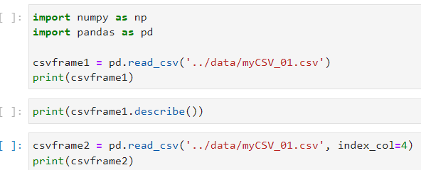
Importing Data into DataFrame
We can read data file in various format into a DataFrame object.
The content of a CSV file can be read in with the read_csv() function and converted to a DataFrame object.
The index_col attribute of read_csv() can be used to designate the row header or primary key.
We can read other formats such as Excel, SQL and JSON.
src13

Slide 46
Manipulating Columns in DataFrame
Adding columns:
A new column can be added by setting the new column name to be equal to an initial/default value, e.g., 0.
We can also initialize the new column to the null value using the NumPy special value np.nan.
Dropping columns:
We can drop a column using the drop() function.
Need to specify the column key and set the axis attribute to 1.
Setting axis to 0 is used to drop a row (default behaviour).

Slide 47
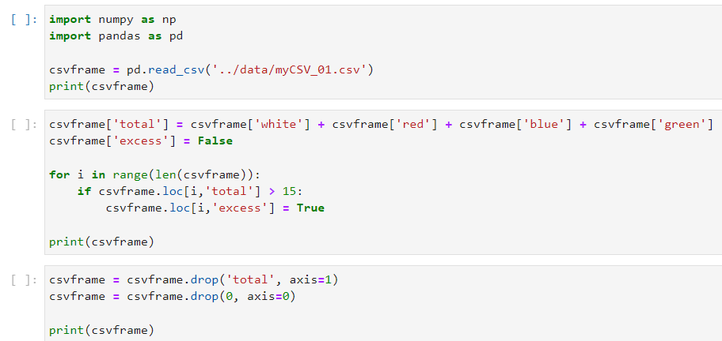
Manipulating Columns in DataFrame (cont.)
src14

Slide 48
Data Visualisation

Slide 49
Matplotlib Architecture
Matplotlib provides a set of functions and tools that allow the representation and manipulation of a Figure (the main object) and its associated internal objects.
Other than graphics, Matplotlib also handles the events and graphics animation.
Thus, Matplotlib can produce interactive charts that can respond to events triggered by keyboard or mouse movement.
The architecture of Matplotlib is structured into three layers with unidirectional communication:
Each layer can communicate with the underlying layer only.

Slide 50
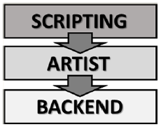
Matplotlib Architecture (cont.)
Scripting layer – Consists of the pyplot interface for actual data calculation, analysis and visualisation.
Artist layer – An intermediate layer representing all the elements that make up a chart, e.g., title, axis, labels, markers, etc.
Backend layer – Matplotlib API and a set of classes to represent the graphic elements.

Slide 51
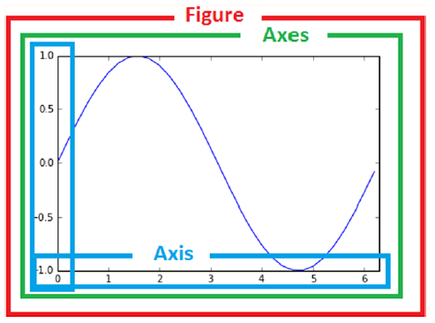
Matplotlib Architecture (cont.)
The three main artist objects in the hierarchy of the Artist layer.

Slide 52
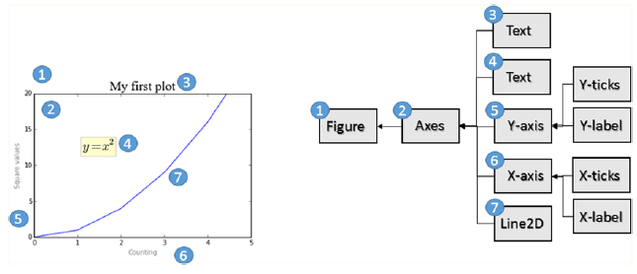
Matplotlib Architecture (cont.)
Each instance of a chart corresponds to an instance of Artist structured in a hierarchy

Slide 53
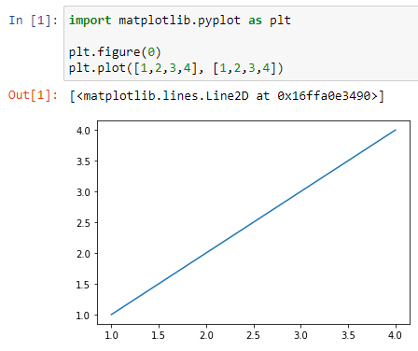
pyplot
The pyplot module is a collection of command-style functions that allow the data analyst to operate or make changes to the Figure.
E.g., Create a new Figure.
A simple interactive chart can be created using the pyplot object’s plot() function.
The plot() function uses a default configuration that does not have title, axis label, legend, etc.
src15

Slide 54
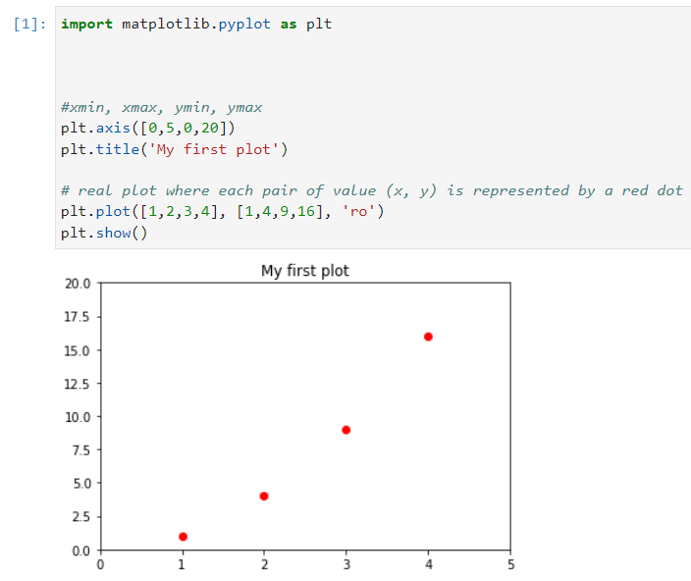
pyplot (cont.)
The default configuration can be changed to obtain the desired chart.
src16

Slide 55
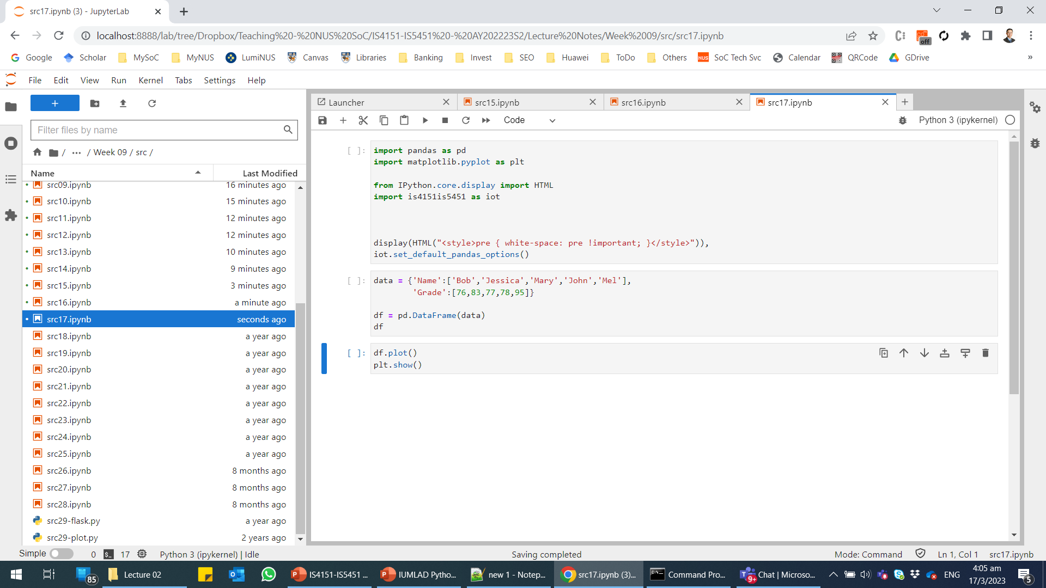
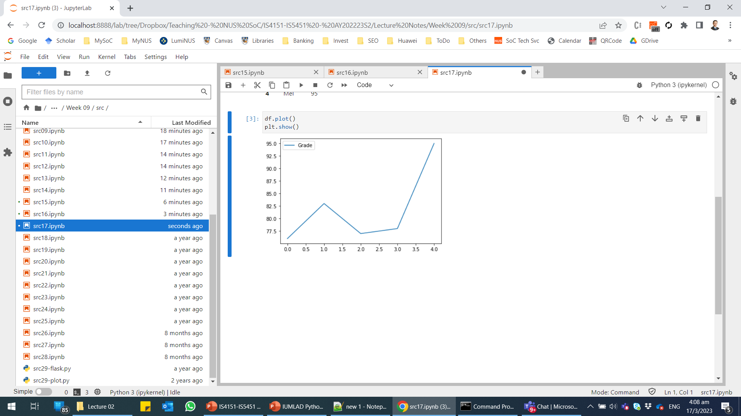
Data Visualisation – Line Plot
To create a simple line plot from data in a Pandas DataFrame, we can use DataFrame.plot(), which relies on matplotlib:
By default, you will get a line plot.
src17

Slide 56
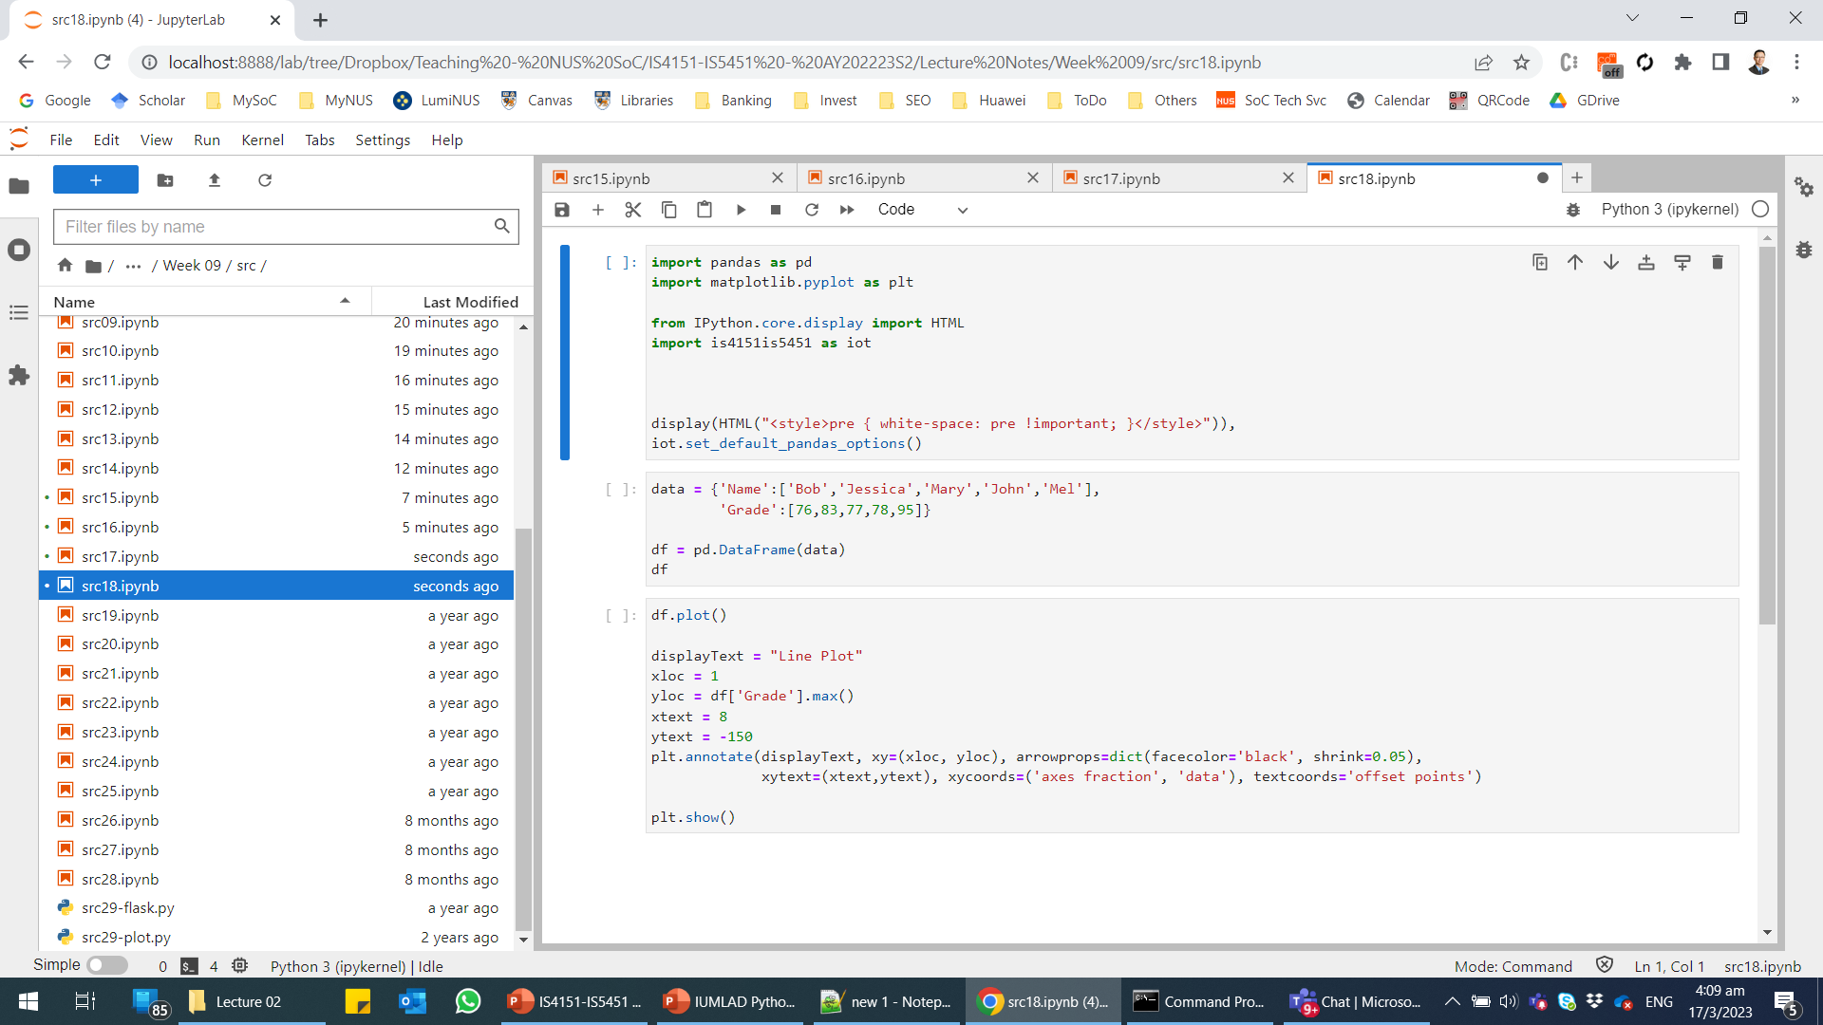
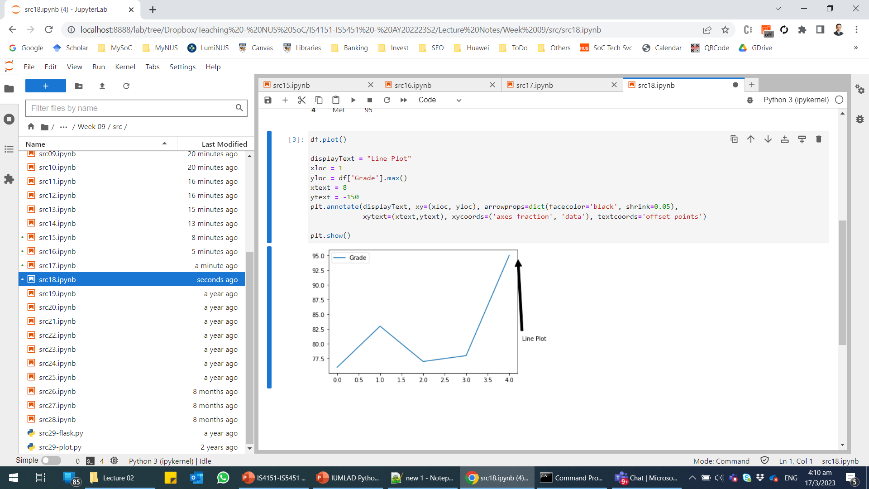
Data Visualisation – Line Plot (cont.)
To customise the line plot, we need to use matplotlib directly:
src18

Slide 57
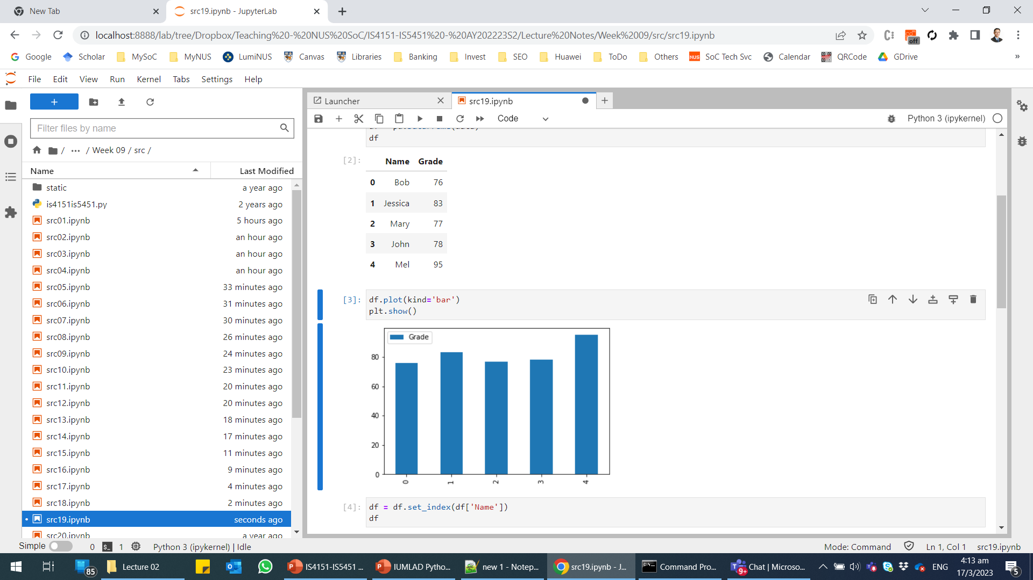
Data Visualisation – Bar Plot
To create a bar plot, we need to set the kind attribute in DataFrame.plot() to “bar”.
By default, the index of the DataFrame is a zero-based number and thus x-axis are the numbers 0 to 4.
We can change the index of the DataFrame to the Name column and replot the bar plot.
See the sample script in src19.

Slide 58
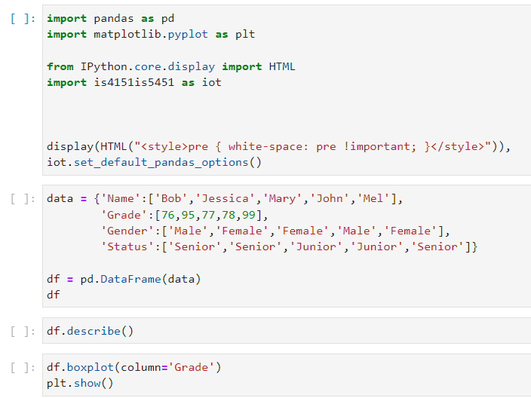
Data Visualisation – Box Plot
A box plot can be created using DataFrame.boxplot() and specifying the required column, in this case, “Grade”.
src20

Slide 59
Data Visualisation – Box Plot (cont.)
A box plot is a method for graphically depicting groups of numerical data through their quartiles:
The box extends from the Q1 to Q3 quartile values of the data, with a line at the median (Q2).
The whiskers extend from the edges of box to show the range of the data.
The position of the whiskers can represent several values:
If there is no outlier, the whiskers show the minimum and maximum values of the data.
If there are outliers, the whiskers show the:
Lowest datum still within 1.5 IQR of the lower quartile.
Highest datum still within 1.5 IQR of the upper quartile.
IQR = Q3 – Q1.
Outlier points are those past the end of the whiskers.

Slide 60
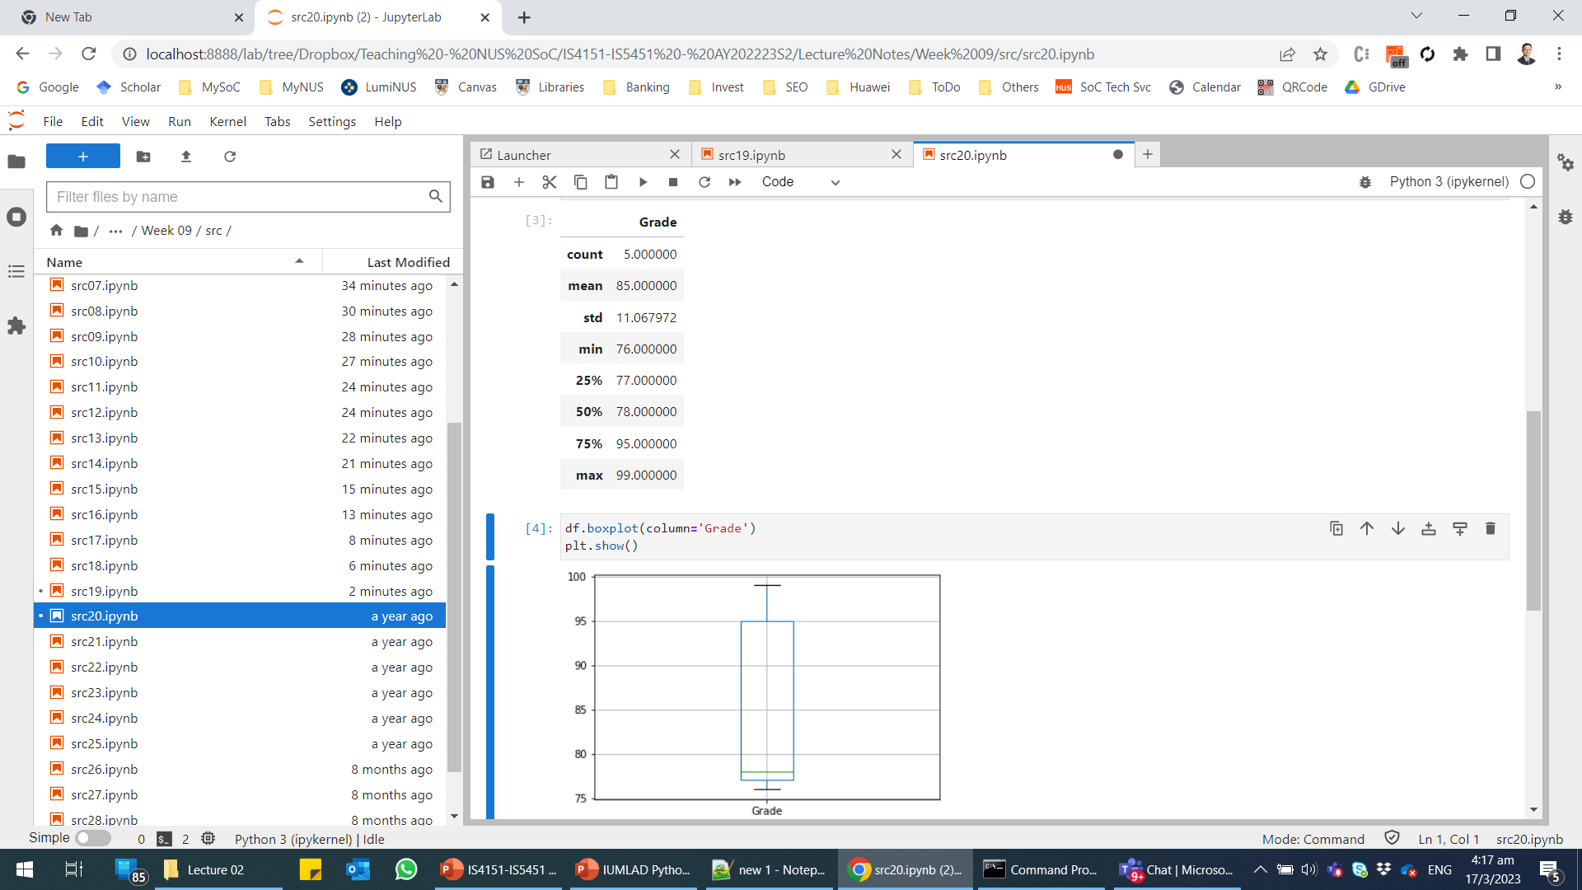
Data Visualisation – Box Plot (cont.)
IQR = 18
Outliers will fall outside ±1.5 * IQR from Q1 and Q3, i.e., 50 and 122
The min and max values are within this range.
src20
In this example, the whiskers shows the minimum and maximum values since there is no outlier.

Slide 61
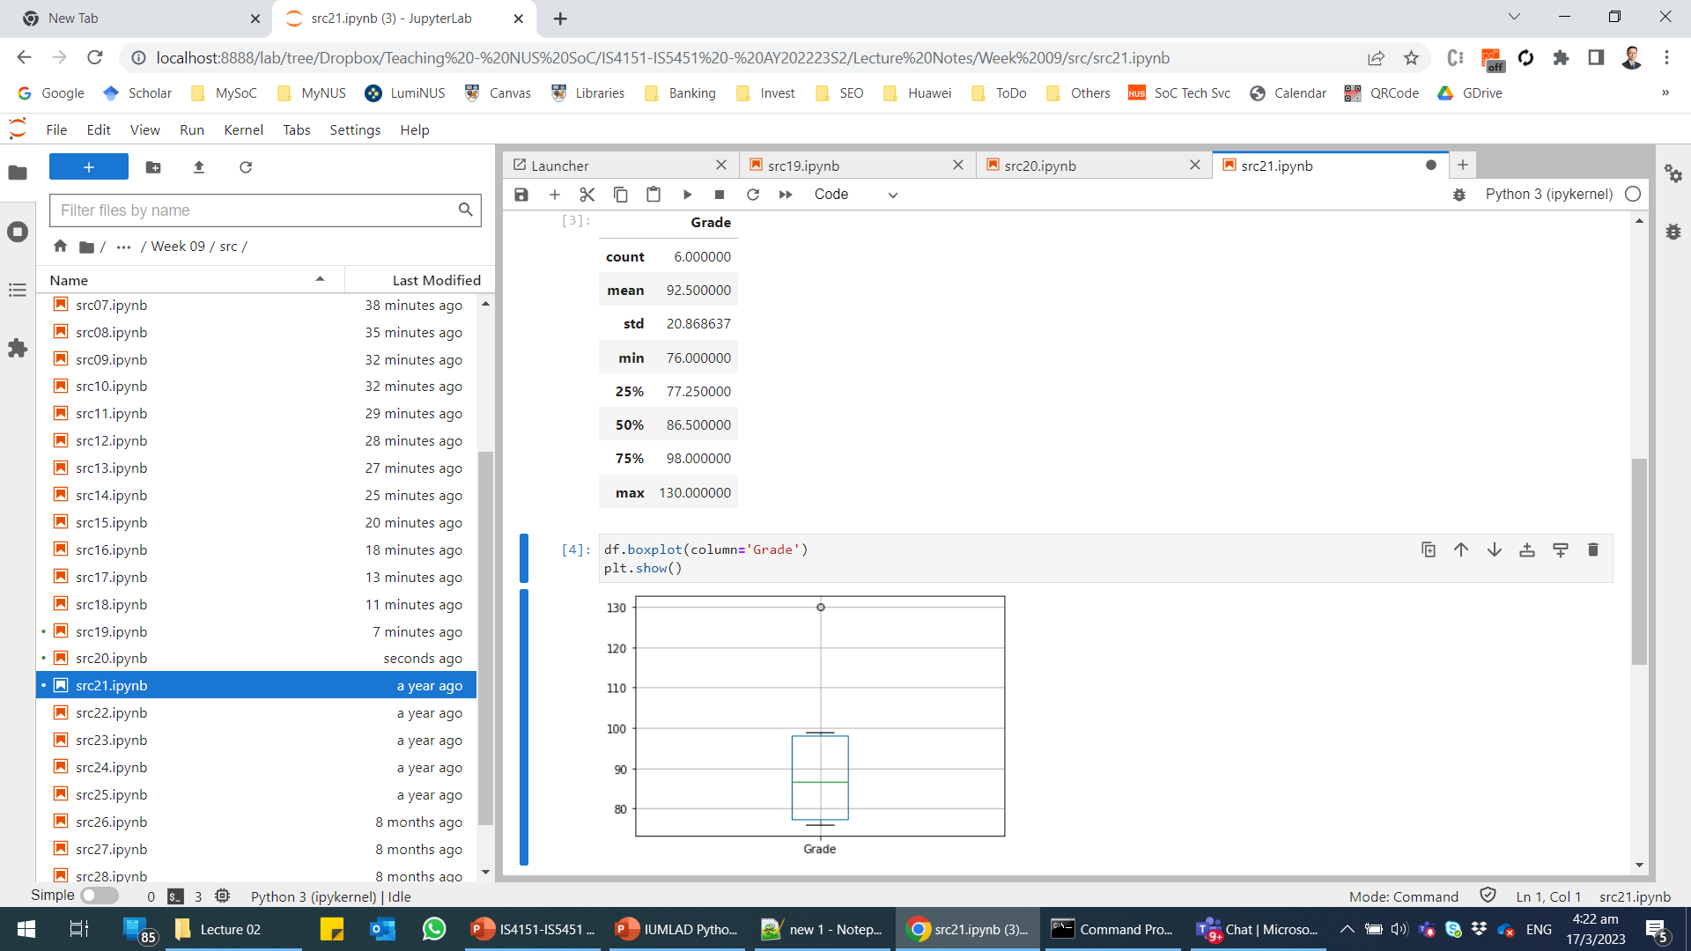
Data Visualisation – Box Plot (cont.)
src21
Adding one extra observation with a Grade of 130 will lead to an outlier
IQR = 20.75
Outliers will fall outside ±1.5 * IQR from Q1 and Q3, i.e., 46.125 and 129.125
The max value is outside this range.
In this example, the whiskers shows the lowest datum still within 1.5 IQR of the lower quartile (i.e., 76), and the highest datum still within 1.5 IQR of the upper quartile (i.e., 99).

Slide 62
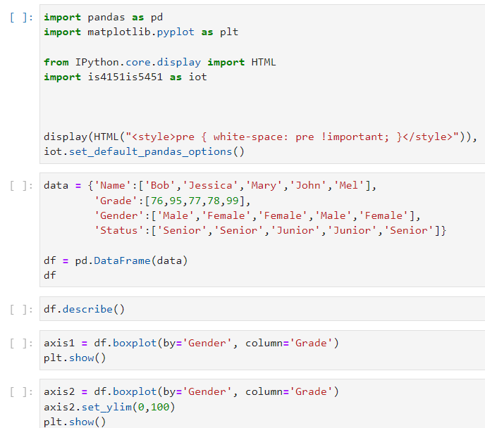
Data Visualisation – Box Plot (cont.)
We can create a box plot with categorisation, in this case by Gender.
We can also adjust the y-axis so that it runs from 0 to 100.
src22

Slide 63
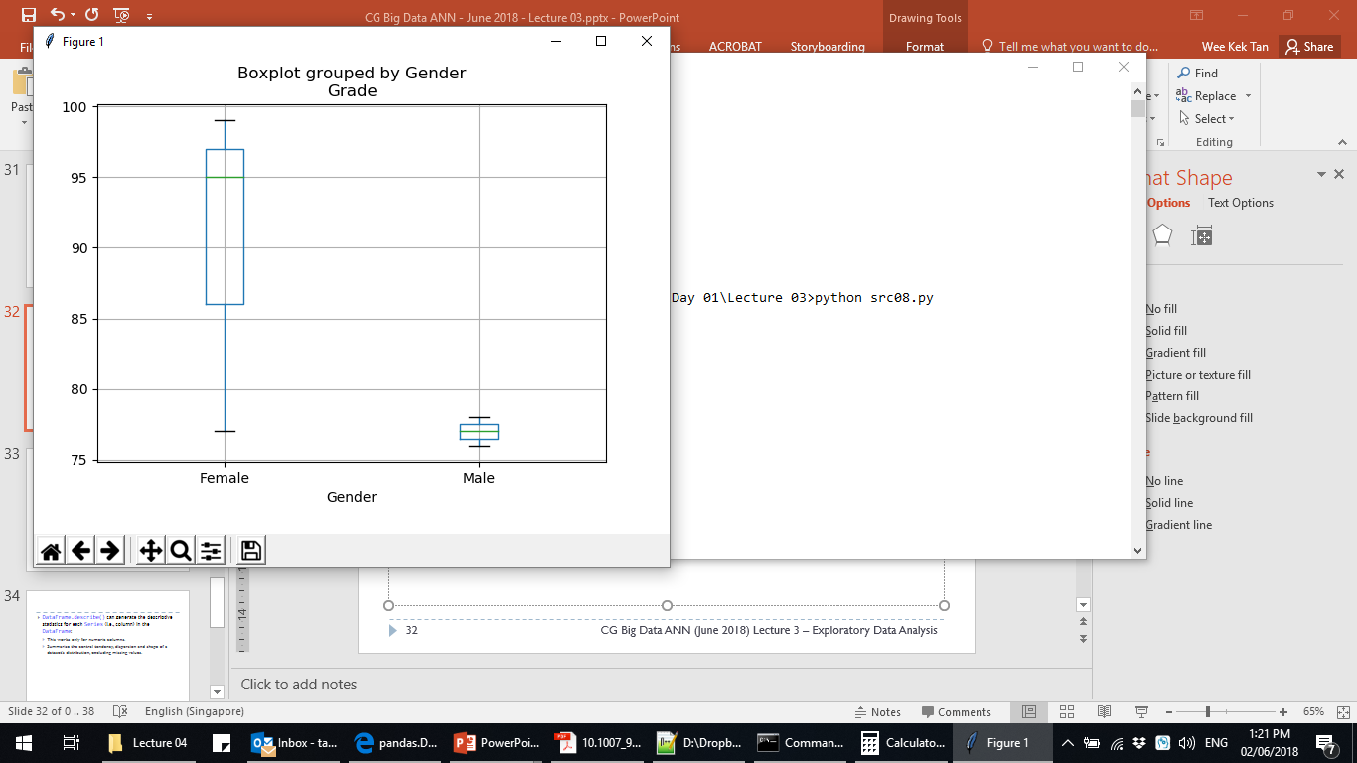
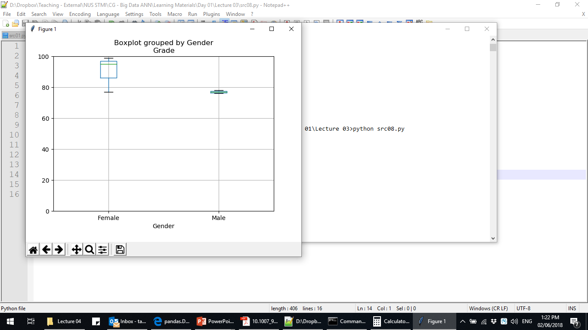
Data Visualisation – Box Plot (cont.)
src22
Box plots with categorisation showing. The one on the right has the y-axis limit set to 0-100.

Slide 64
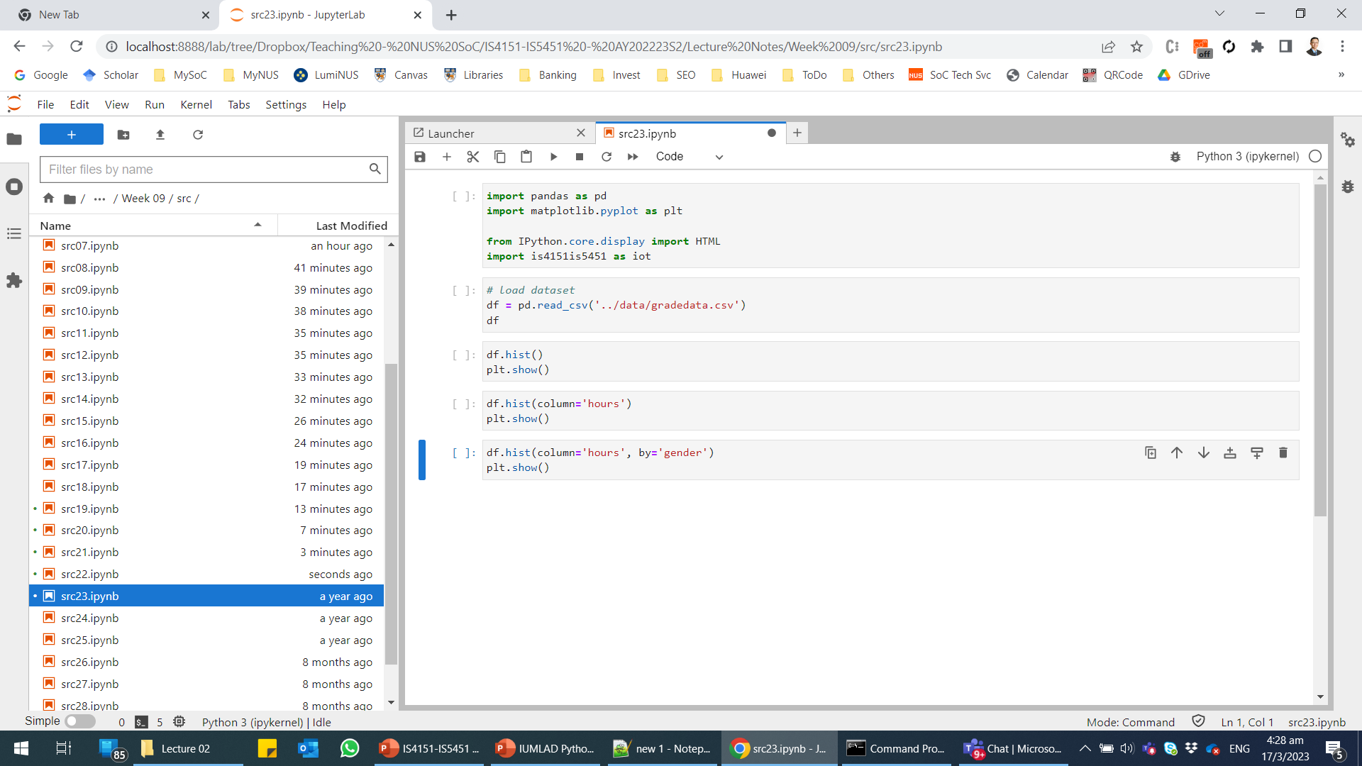
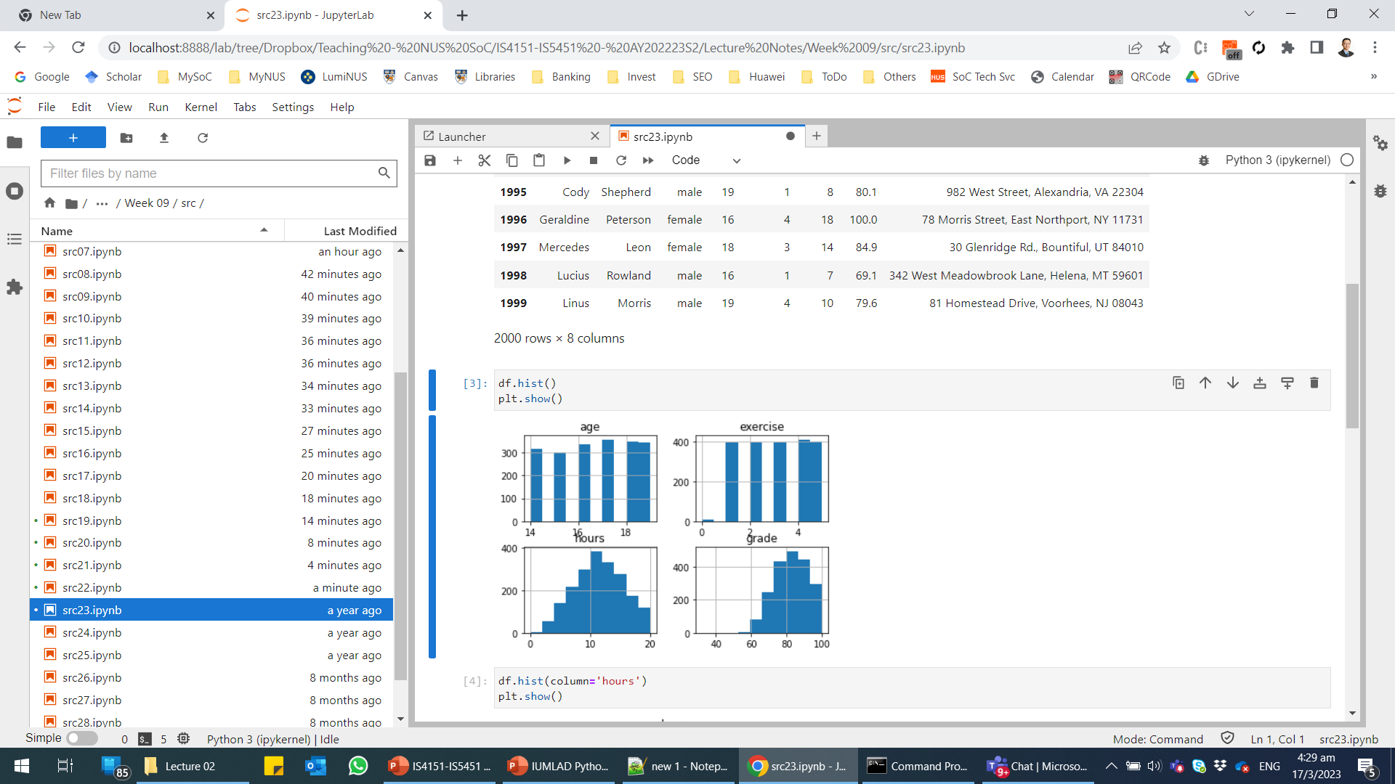
Data Visualisation – Histogram
A histogram can be created using DataFrame.hist()
By default, the histograms for the columns with numeric values will be generated.
To generate a histogram for a particular column, you can specify the name of the required column in the column attribute, e.g., df.hist(column='hours').
src23

Slide 65
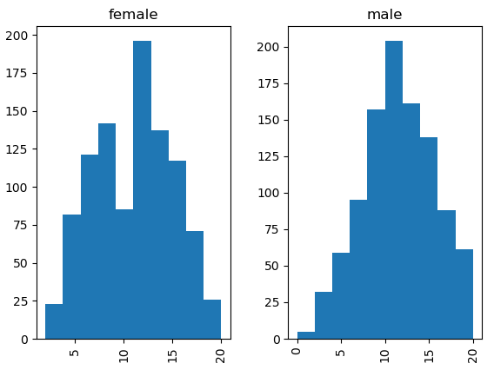
Data Visualisation – Histogram (cont.)
We can also generated histogram for a numerical column grouped by another column, typically a categorical column, using the by attribute.
See src23 for a sample script grouped by “gender”.

Slide 66
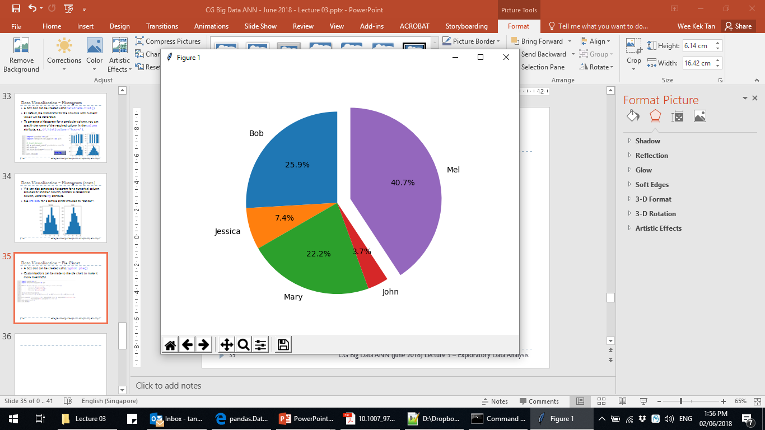
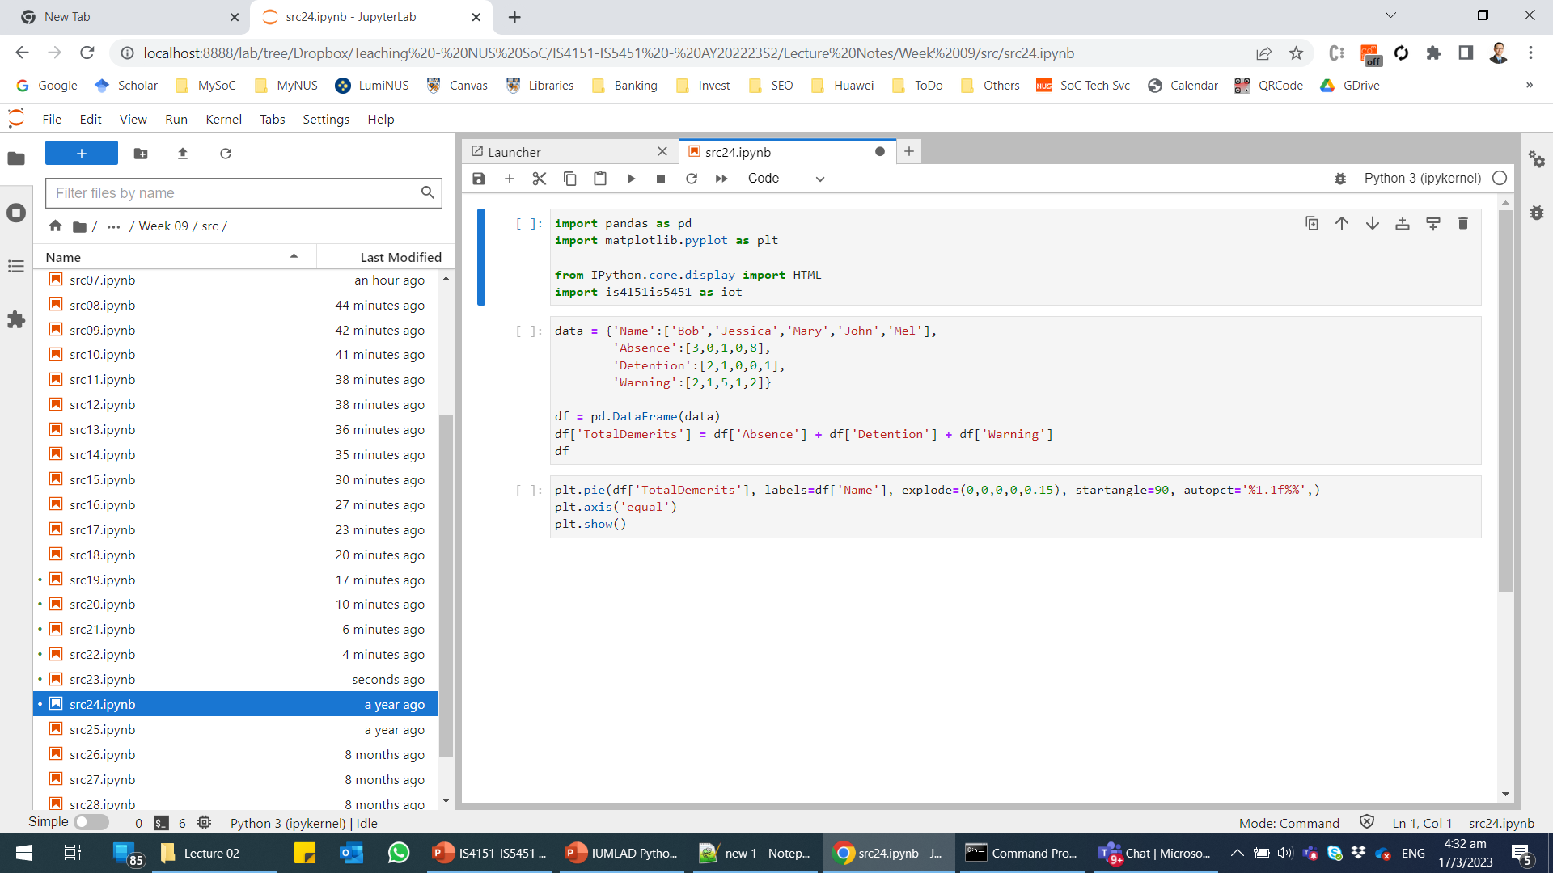
Data Visualisation – Pie Chart
A pie chart can be created using pyplot.pie().
Customisations can be made to the pie chart to make it more meaningful.
src24

Slide 67
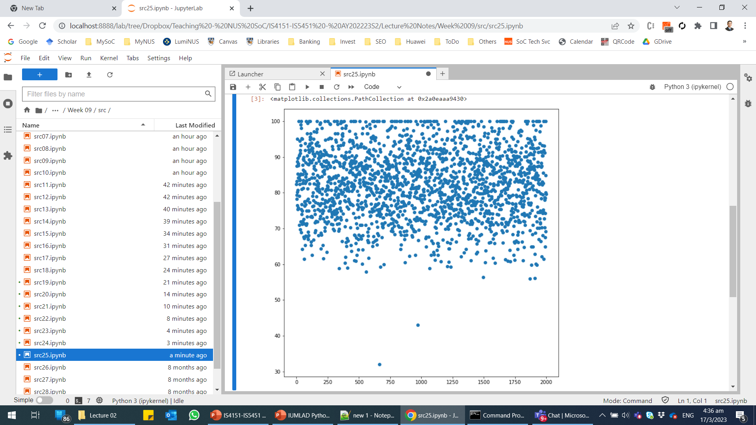
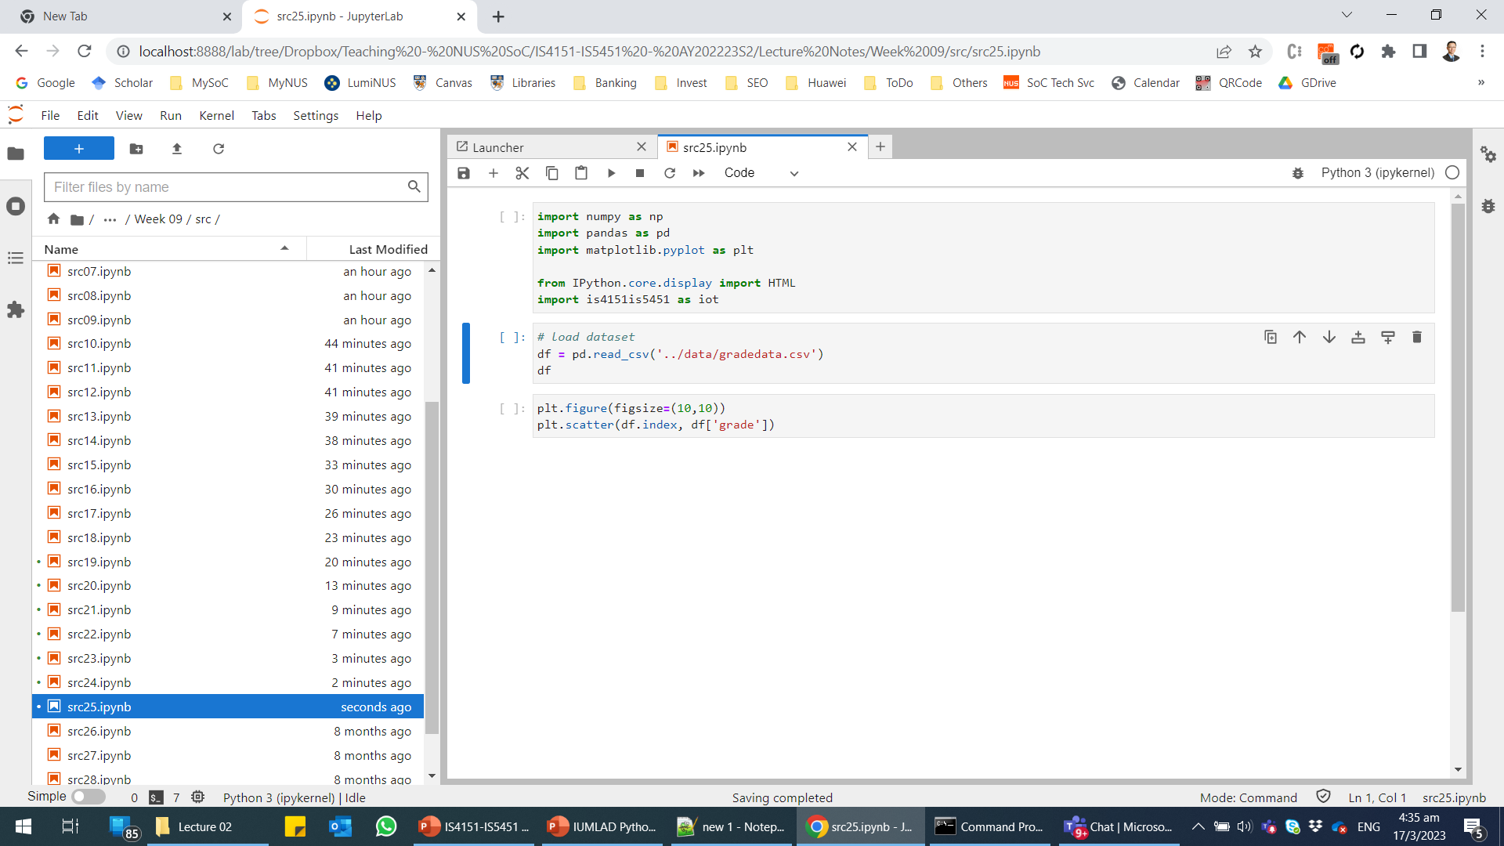
Data Visualisation – Scatter Plot
A scatter plot can be created using pyplot.scatter().
src25

Slide 68
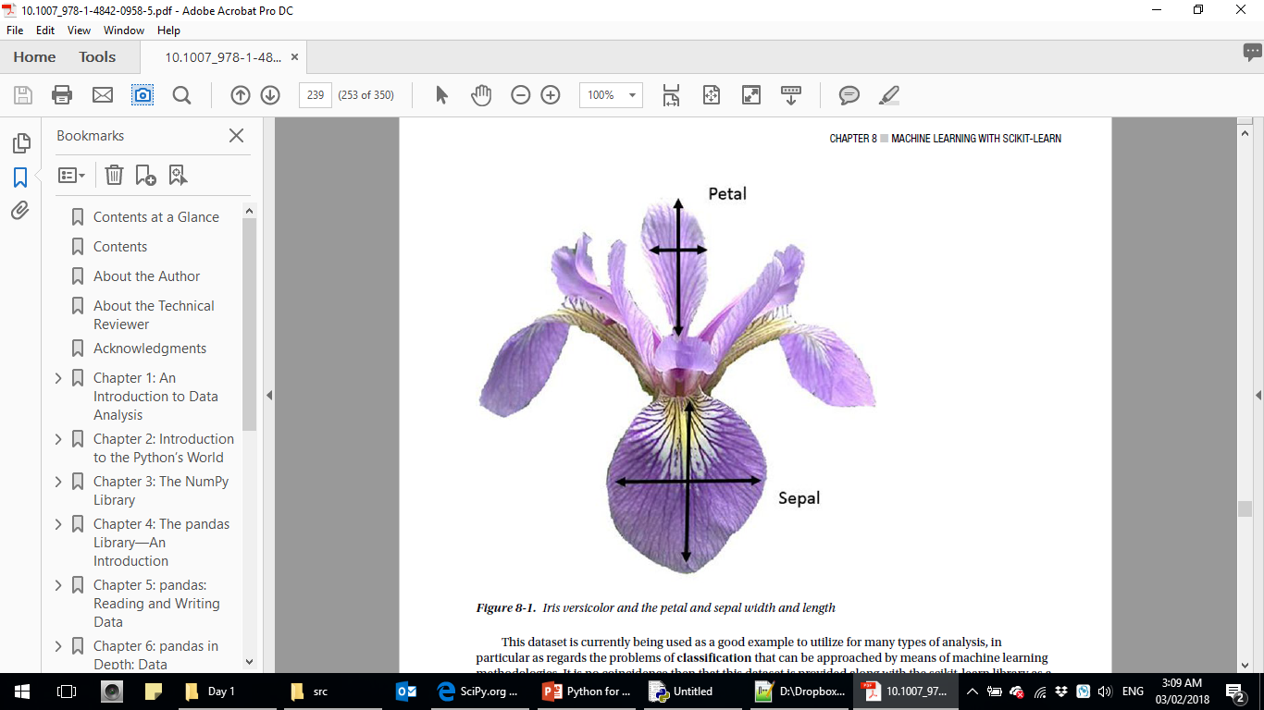

Data Visualisation – Scatter Plots of the Iris Flower Dataset
This dataset set contains data from three different species of iris (Iris silky, virginica Iris and Iris versicolor).
The variables include the length and width of the sepals, and the length and width of the petals.
This dataset is widely used for classification problems.
150 observations with 4 independent attributes and one target attribute.
src26

Slide 69


Data Visualisation – Scatter Plots of the Iris Flower Dataset (cont.)
Which variables are better for predicting iris species?
src27 – Scatterplot of sepal sizes.
src28 – Scatterplot of petal sizes.

Slide 70
Integrating Matplotlib into an IoT Application
We can use Matplotlib to generate data visualisations for our IoT sensor data:
Export the visualisations to image files.
Serve the image files via a Flask web application.
This approach can be used to create a simple data dashboard.
Refer to the following sample source files:
src29-plot.py
src29-flask.py

Slide 71

Integrating Matplotlib into an IoT Application (cont.)

Slide 72

Summary
Data mining is a process that extracts useful knowledge (or patterns) from data using statistical, mathematical and artificial intelligence techniques.
Data mining tasks may be classified into prediction, association and segmentation.
Each data mining task can be implemented with various algorithms.
Python provides many data science libraries that can be used for IoT data analytics.
Data preparation helps us to pre-process the data for the subsequent analysis.

Slide 73
Summary (cont.)
Data visualisation helps us to better understand the data and also function as a data analytics output by itself.

Slide 74

Q&A

Slide 75

Next Lecture…
Learn about:
How to perform prediction with regression analysis.
How to perform prediction with classification.
IoT Development
AI Machine Learning
Single-board Microcontroller
Single-board Computer
IoT Backend Integration
Android Development for IoT
IoT Data Preprocessing
Machine Learning for IoT Data
Computer Vision for IoT
IoT Architecture, Design and Protocols
Pervasive Computing
Technical Concepts
Introduction to Artificial Intelligence of Things

